Slide 1
From good to exceptional—and beyond
HP FY16 Channel Strategy | October 2015
Prepared by iris Worldwide
Notes:
As we move into FY16, HP is poised to surge forward and move from good to exceptional. We have a lot planned, but a strong channel means overall HP health and success, so let’s get started.

Slide 2

This is the start of something amazing. It’s time for all of us—together—to move from good to exceptional.
Notes:
We aren’t here today just to talk about new program details. We’re not simply introducing a new compensation model, or industry partnership, or a series of marketing buzzwords. We’re here because it’s time for all of us—together—to move from good to exceptional. What we’ll be talking about today is an exciting and comprehensive new channel sales strategy, one that will affect every program, every tool, every partner—and you—directly.

Slide 3

Why?
Notes:
Why do we need to do this? You might say, “we’re doing just fine” or “our channel is strong in the IT industry.”
Exactly. We’re strong—for our industry.
But our industry is lagging. We experienced so much growth over the last few decades that none of us stepped up and figured out how to make our channel activities truly exceptional.
I don’t have to tell you that worldwide PC Shipments Declined almost 10 Percent in the second quarter of 2015.
But what you do need to hear, is that this downturn truly is an opportunity for us as a channel.
Because the channel partner that separates itself from the pack during a downturn has the opportunity to truly dominate the market.
That’s why, now, in 2015, we want to move beyond the frontier, into uncharted territory.

Slide 4

Our vision
To create and implement a channel model that is the aspiration across
all industries
Notes:
We don’t want to be the aspiration just in our industry. We want to be admired from afar—across every industry.
We’re going to look at examples in this presentation from consumer goods, from auto, and others—industries that have truly mastered the channel.
It is our goal that we will be one of those exceptional models.

Slide 5

Our mission
Increase channel engagement & ease of doing business through
Innovative tools & processes
Simple & consistent strategy & execution across markets & geographies
A disciplined & professional sales force
Notes:
But what do we do—tangibly—in order to become that aspiration for others in our industry (and in other industries)?
Moving forward, we want to:
Increase channel engagement and ease of doing business through:
Innovative tools and processes. It’s not EASY to work with HP today. We want to make it fun, exciting, and EASY to do business with us—so that our partners and our retailers make more money. We want to optimize the way they sell so they want to work with us far into the future.
We want our programs, tools, and processes to deliver simple and consistent experiences across markets and geographies. No matter where we are, we want consistent communication, processes, and ways of working so that it’s always better to work with us than to work with someone else.
And we want to do so with a disciplined and professional sales force. We don’t say “disciplined” to make it seem like everyone needs to be obedient and militant. BUT we want a team that is focused, prepared, trained, and ready for any sales situation. We want everyone in sales to be comfortable and at their best—whenever there’s an opportunity to win.

Slide 6

Our strategy is about going from good to exceptional
Good
Exceptional
Notes:
To achieve that mission and live our vision, we are on a journey, moving from Point A to Point B—from good to exceptional. And beyond. Once we hit “exceptional,” we want to continue pushing until we are the standard for channel success.

Slide 7

Where are we now?
Notes:
But first we have to know where we are today. The new HP channel strategy begins with our legacy as the industry’s leading and longest running program. That hard work, dedication, and steady program improvements, particularly in the last 3 years, have positioned us for success.

Slide 8

Our path
FY 17 & Beyond…
Becoming exceptional
FY16
Acceleration
FY15
Acceleration
FY14
Recovery & expansion
FY13
Fix & rebuild
FY12
Diagnosis & foundation
Notes:
In FY2012, we started designing the blueprint. We began moving forward as a channel by listening to you--the sales force--and our channel partners directly. We opened up a dialogue, and learned about your goals and obstacles. We found out what you needed, and what we needed to change.
In FY2013, we started the process of rebuilding the channel program. Our goal? To become simple, profitable, and predictable. We redesigned our Go-To-Market strategy and partner engagement, and simplified the program and compensation structure.
In FY2014, we laid the groundwork with a new PartnerOne program that was launched across regions and business groups, as well as a joint business plan, joint KPIs, and new channel tools to enhance the partner experience.
All that created the solid foundation we’re building on today. Now, in FY2015, we’re starting on a new, expanded journey as the new HP. We’re building towards excellence.

Slide 9

Our progress so far
Partner program & compensation simplification
Increased partner benefits
Streamlined certifications and requirements
New PartnerOne program launched cross-regions, cross-BGs
New channel tools enhance partner experience
Channel process & tool upgrades
Notes:
This path has brought great improvements and results for partners and the sales force so far:
We’ve moved from different membership structures for each region/business unit to one globally consistent membership framework across all business units
Our compensation structure improved from unpredictable rebates due to gates, caps, and product exclusions to rebates on all products from the first sale—with no gates, and no caps
And our certification requirements have gone from difficult, inconsistent, and limited to streamlined, consistent, and greater availability with up-to-date content

Slide 10



Why now?
Because we can
The new HP is also a new opportunity
Because we must
As soon as someone else starts running, we’ll fall behind
Notes:
And why are we doing this now? Why build higher? We’re doing it for two reasons:
On one hand, the new HP is a new opportunity for us to embrace the future—the newness—for a fresh start. Like Dion says, we want the heart of a startup combined with the strength of a Fortune 100 company. And that’s why we’re in such a great position to capitalize on that opportunity. We have the nimbleness and focus now that means we CAN achieve excellence.
On the other hand, we MUST make a change. Like I said earlier, our competition has been complacent, almost stagnant. We’re ahead of the game now… but we’re only a FEW steps ahead. We’ve all been complacent, only walking forward when other industries have been racing ahead. If ANY of our competitors starts running now… we’ll get trampled.

Slide 11
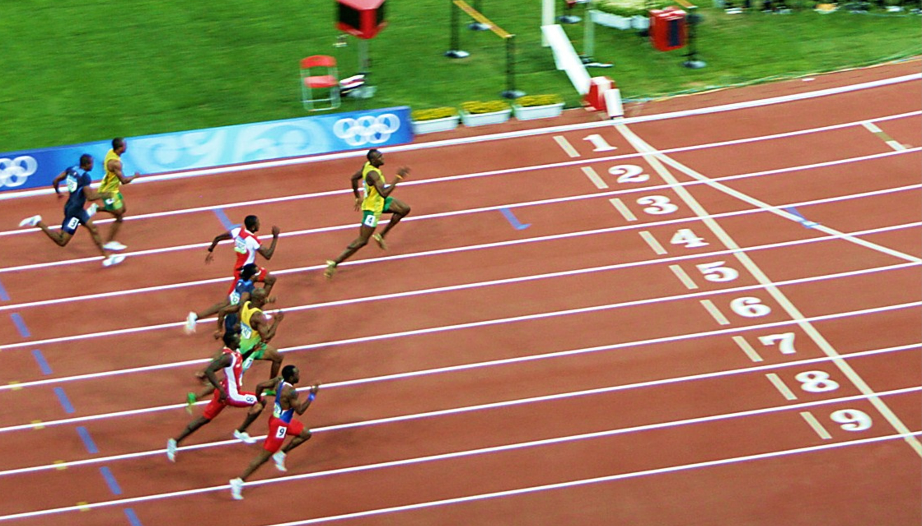
The technique
The training that will help us excel in our initiatives
The target
This year’s 3 key objectives
The track
The initiatives that will help meet our objectives
Notes:
Sound daunting? Well, we have a plan.
Beginning on Day 1—November 1st—we’ll be rolling out initiatives under 3 key pillars: the track, the target, and the technique.
The target is all about our goal. Where are we going together? What are we aiming for? These initiatives promote innovation and tools that will enable the Playing to Win framework and push profitability. They make it easy to do business with HP. It’s about being prioritized and focused on our aims—and having a common set of goals and aspirations, which is possible now that we aren’t so weighed down by business units and conflicting interests.
The track is all about our path. What road are we on together? These initiatives are what will make HP’s channel simple and consistent across markets and geographies. They’re what will make people want to work with us and what will make our partners excited about us.
The technique is about our journey. How are we going to get where we’re going? How are we going to do it WELL? These initiatives are heavily based in training—in understanding why we need to prepare, what we need to prepare for, and doing so in a relevant and engaging way that is tailored to our specific needs. So that we’re all ready for action and never going in unprepared.

Slide 12



Let’s think about it like this…
1. The Target
We need to know where we’re aiming
2. The Track
We need consistency in what we’re doing
3. The Technique
We need to know how to get there better
Notes:
Let’s look at it another way.
If you think about golf, the “target” is the hole—we know that we always want get there with a minimum number of strokes, so understanding where it is and imagining it every time we swing is key to making sure we always have that goal in mind. We used to have a lot of conflicting goals and too many priorities. Zeroing in on what’s REALLY important to us and using the Playing to Win framework will help us keep our priorities in mind.
The “track” is the tee, the reliable setup. Different holes have different layouts, but before you can adjust, you first need to have a consistent and efficient start, on a reliable track. So, for our purposes, this is about having consistency in what we say, how we say it, and what we do in the channel.
And the “technique” is how you develop a truly great stroke, it’s how you execute. It’s practice, insight, intuition—everything that makes up good training. For us, this means that preparedness is really what’s going to help us reach those goals consistently and successfully.

Slide 13

The target
It’s time to move better—together
The technique
The track
Notes:
Put simply—it’s time to move better together.
We’ll look at what’s included in all of these pillars later—but first, we need to understand why they’re important to us and what our aspiration is for each.
Let’s look more closely at the how & why.

Slide 14
1|The target
Notes:
Consistency alone isn’t enough to go from good to excellent. We need the innovations and tools that will let us focus on Playing to Win and profitability.

Slide 15

If I throw 10 balls at you at once, you’ll probably catch 0.
Notes:
Why do we need focused goals and priorities?
Think about it this way.
If I throw ten balls at you at once, you probably won’t catch any of them.
Too many priorities means too many directions to move in at once.
If we go after every sale and every customer, we’re wasting a lot of our time and energy as a channel.

Slide 16

…but if I throw you one ball really well, you can catch it every time.
Notes:
By focusing on the right vendors and markets, we can become more profitable, predictable, and easy to do business with.
We avoid being spread too thin, and become more efficient and competitive in everything we do.

Slide 17


our aspiration
The automotive industry
Automotive brands have a history of sharing information across dealerships—VINs, names, history—so they always know what you need before you need it—and what you don’t.
Notes:
Playing to Win may not be easy, but the rewards are clear.
In the automotive industry, Playing to Win means targeting consumers with the right product, in the right context, at exactly the right time.
Despite national networks of thousands of franchises and central offices, channel networks like GM’s regularly share information across dealerships—from VINs to names to vehicle history
They do this so that they can stay focused on what’s most important to their customers, and deliver an exceptional experience every time.

Slide 18

our aspiration
The automotive industry
Why do they do it?
To give dealers focus
To prioritize objectives
To elevate brand
To help ALL dealers
Notes:
Sharing that information and setting priorities isn’t done by the automotive industry in order to steal leads or information from their franchises.
Instead, manufacturers like GM and the franchises know that by sharing information and priorities, they:
Gain focus and efficiency.
Elevate the brand and the customer experience.
And ultimately help the entire network achieve better results than they would ever be able to do on their own.

Slide 19
2|The track
Notes:
First we need to understand why we’re focused on being simple and consistent across markets and geographies.

Slide 20
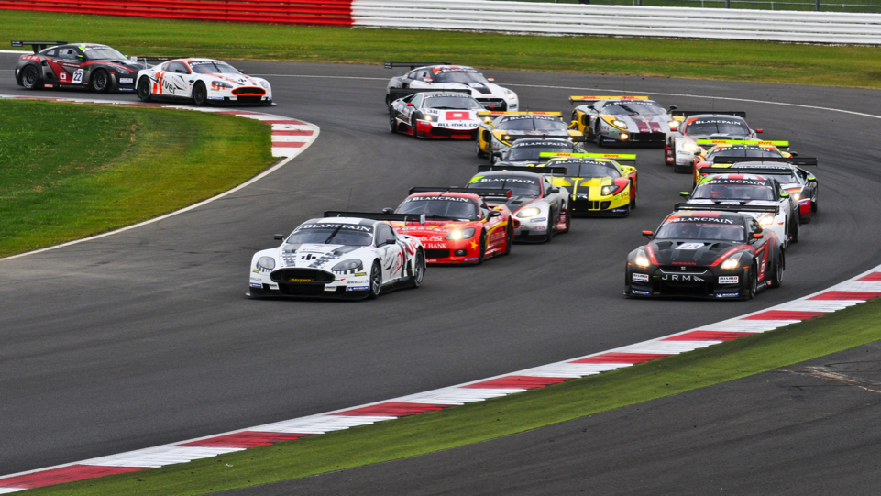
Have you ever wondered why race cars, migrating geese, or bicyclists closely follow behind each other?
Notes:
Let’s look at another example of consistency.
Have you ever wondered why cars, a flock of geese, or even bicyclists follow closely behind each other?
If you’re familiar with drafting, you know that as the car moves forward it pushes the air in front of it aside.
This produces a low pressure area behind the car.
If you're a following close behind that front car, you can gain an advantage. The low pressure area pulls you forward, so you don’t have to use as much gas to go the same speed.
This is a huge advantage. Air may seem like an easy thing to move through, but just stick your hand out the window when driving down the highway, and you can feel how it pushes against your hand.
Likewise, with our channel program, inconsistencies across markets and geographies drag our efficiency down, costing us more time, resources, and ultimately sales.

Slide 21
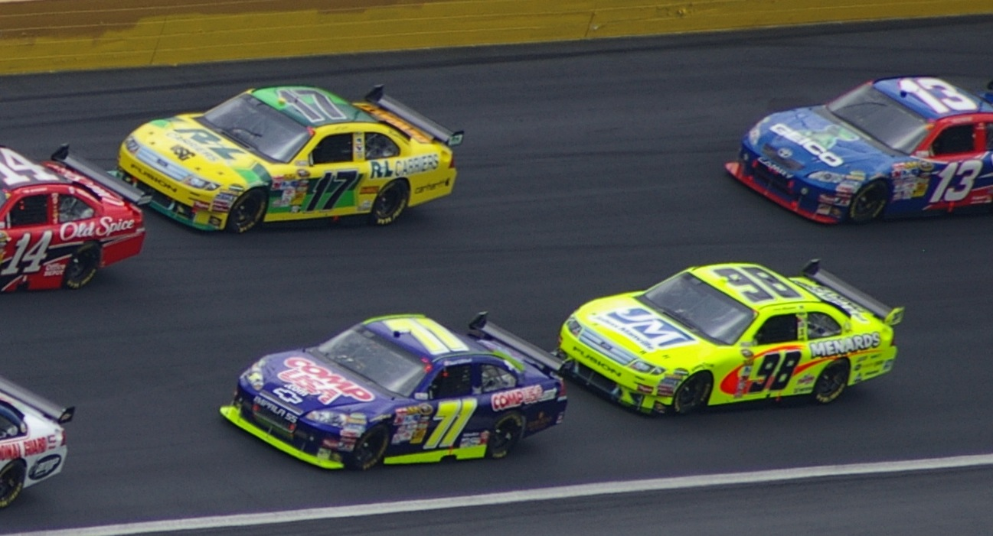
Consistency + path
= easier for everyone
Notes:
There’s something really neat, though, that even people familiar with drafting might not know.
When a car drafts, following close behind the front vehicle, it fills in the eddy of turbulent air behind that front car.
And it actually improves the front car’s performance as well.
So two drivers who are drafting can put out less energy than two other cars that aren’t drafting, going the same speed and the same distance.
Consistency in our channel programs isn’t just better for some of us, it’s better for ALL of us, as we can spend less time adjusting across markets, more easily leverage our assets and distribution channels, and provide a simpler, more predictable experience for us and our partners.

Slide 22
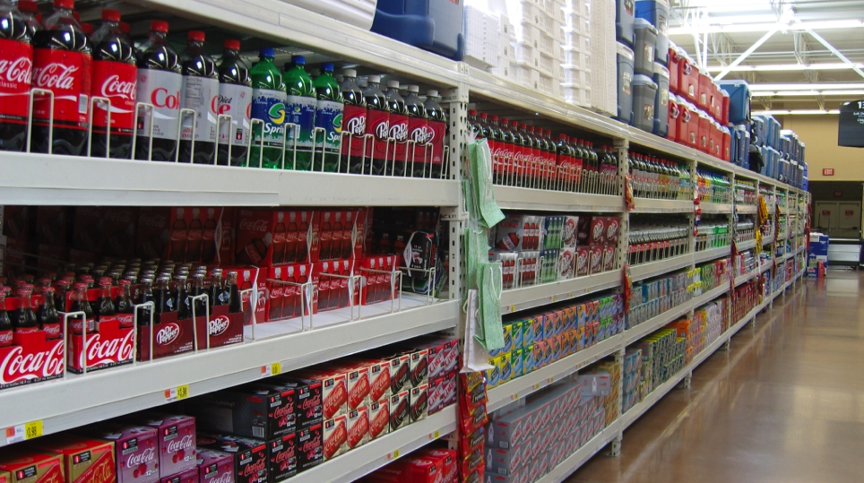


our aspiration
Coke merchandisers line up outside retail stores at 5am to get in and ensure displays are correct before open.
Notes:
Sound difficult? It’s already being done in other channels.
Take Coca-Cola, for example. Coke merchandisers know the value of consistency and excellence.
And they make it happen by lining up outside of retail stores across the country at 5am, to get in before the stores opens to ensure:
That displays are correct.
That there’s enough merchandise.
That it’s properly stored.
And that associates are aware of new products and current marketing efforts.

Slide 23


our aspiration
The FMCG industry
Why do they do it?
So selling is optimized (i.e., sales come easily)
So partners want to work with them
Because consistency = ease
Notes:
Why do they go through so much effort?
It’s not just because they’re perfectionists, or want to make life difficult for their retail partners. It’s because they know that when selling is optimized, sales come easily.
A better experience for consumers is also a better experience for their partners, ensuring they’re maximizing their sales and minimizing the effort needed per sale.
For the same reasons, FMCG companies like P&G use category managers to ensure consistent displays where their products are grouped and merchandised together and prioritized correctly for each market.
The consistency in packaging, displays, and even the order that products are placed on the shelf helps create a seamless experience for consumers, minimizing the friction between them and the checkout line.
While there are differences in purchasing preferences in different regions, consistency across the products gives consumers in any region a superior experience and makes sharing resources much more effective.

Slide 24
3|The technique
Notes:
After achieving consistency and zeroing in on our highest priorities, we also need to ensure we have the relevant training to become a disciplined and professional sales force.

Slide 25
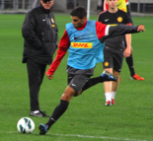
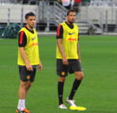
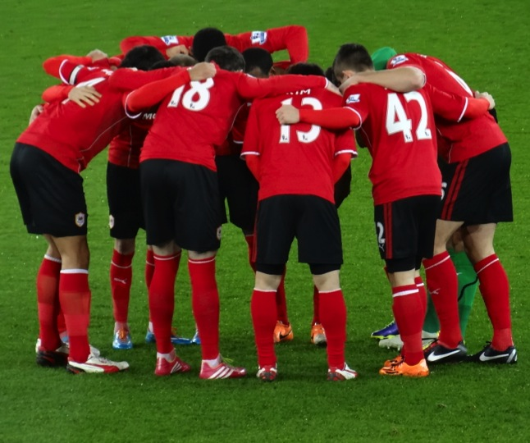
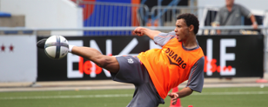

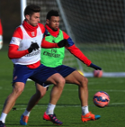

1
2
3
1 week = 6 practices +
ONE MATCH
4
5
6
Notes:
The game is one day a week, training is 6 days a week. Why?
Because going into a sales meeting without knowing all the fundamentals is like jumping out of a plane without a parachute or entering a burning building without fire gear.
We would be astounded to find that a professional athlete doesn’t spend thousands of hours in intense practice.
Yet we often feel we don’t need to practice, study, and perfect our skills in order to excel as individuals, and as a channel.
When is the last time you practiced 6 times for a sales call?
As we move forward in the journey from good to excellent, we need to practice hard in order to make sales easy.

Slide 26
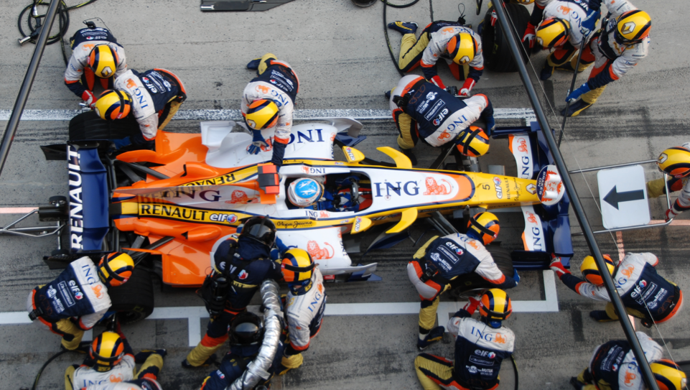
Know what everyone’s doing—but practice for your role on the team.
Notes:
And practice isn’t just about putting the time in.
Imagine a goalie who only practices offensive moves.
Or a quarterback who spends all his practice time kicking.
That’s why pit crews are so impressive. They can complete a pitstop in only 1.923 seconds, because everyone knows and has practiced over and over again for their particular roles.
Our training needs to be relevant, engaging, and timely. That’s why we’re focused on providing targeted, focused training paths that will make effective use of the time you put into them.
We promise they’ll be worth it. But it’s up to you to take the time to complete them and achieve excellence.

Slide 27
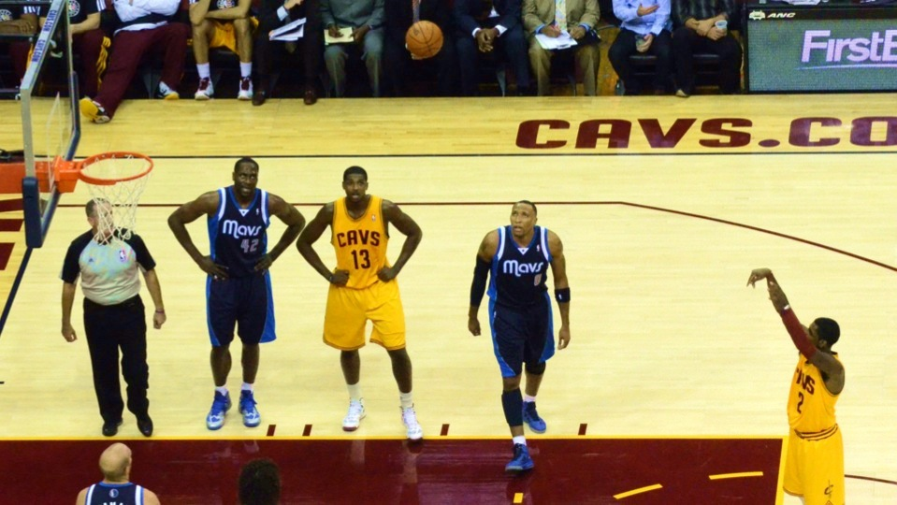
And practice the fundamentals so you can apply them when you need to.
Notes:
Time and again, basketball games are won and lost at the free-throw line. It’s the fundamentals that see a team through to the win.
And that’s just as true for us.
To excel, we need to train not just on the newest product or prospect, but on the fundamentals. Selling, persuasion, public speaking.
Even after we’ve mastered these skills, we need to continually refresh and practice them to keep ourselves in top form.

Slide 28


our aspiration
The famous Hamburger University of McDonald’s invites franchise managers to learn all it takes to run a multi-million dollar business.
Notes:
It can seem almost silly. A university dedicated to flipping patties and selling fries?
But a large part of how McDonald’s has achieved market dominance—with 68 million customers daily, in 119 countries, across 35,000 outlets—is their dedication to effective training.
They’ve understood that whatever the arena, from hamburgers to workstations, effective training is the key to winning.

Slide 29

our aspiration
Why do they do it?
Executives learn to manage
Franchisers learn all roles in their stores
Franchisers can train employees for each role
Notes:
From the most basic tasks to fundamentals of management, executives and franchisers learn everything there is to know about their business.
And that training enables an incredible consistency and efficiency in the McDonald’s product and customer experience—anywhere in the world.
Likewise, we need a renewed focus on the fundamentals of selling, on becoming experts in our fields, and on being fully prepared for every opportunity.

Slide 30

What are we planning to do about it?
The target
The track
The technique
This year’s 3 key objectives
The initiatives that will help us meet our objectives
The training that will help us excel in our initiatives
Simple & consistent across markets & geographies
Innovation & tools that enable Playing to Win and ease of business
Targeted training that enables a disciplined sales force
Playing to Win investment framework
Simplified partner structure
Prioritized coverage model
Top partner relationships
JBP quality & utilization
Standardized sales processes, insights, & tools
RtM simplification
WW channel governance model
Partner First portal & training
Sales competence training & assessment
“Lifetime of Learning” (Role-based)
Sales management training
Notes:
To support you on this journey, we’re rolling out a lot of new goals, initiatives, updates, and tools.
The common themes among all of these changes are the creation of a consistent, targeted, and well-trained channel program that is the aspiration across industries. As we enter a new era with a new channel program, we’re going to move better—together.

Slide 31
What are we planning to do about it?
The target
Increase channel engagement & ease of doing business |  | Simple & consistent strategy & execution across markets & geographies
 |  | Innovative tools & processes
 |  | A disciplined & professional sales force
Notes:
That movement begins with a clear set of priorities. Going into FY16, every move we make needs to support and further one or more of these 3 channel priorities.

Slide 32
What are we planning to do about it?
The track
Playing to Win investment framework | Define winning, where we’ll play, how we’ll win, and what capabilities and systems must be in place
Simplified partner structure | Roll-out a consistent partner benefit and compensation structure, and develop an optimized partner landscape
Prioritized coverage model | Organize our channel sales teams for growth and focus on key priorities
Top partner relationships | Develop a closer relationship with top partners in the distribution, commercial, and consumer markets
JBP quality & utilization | Continuously develop and maintain Joint-Business Planning across HP’s top partner accounts to drive engagement and growth
Standardized sales processes, insights, & tools | Launch productivity and usability enhancements—including providing JBP, heat maps, dashboards, SFDC—and fully integrate growth initiatives across all routes to market
RtM simplification | Clear messaging and processes for Route to Market and fulfillment choices
WW channel governance model | Improve the efficiency of HP’s channel governance across regions and functions by executing on a simplified and consistent framework (engagement, reporting, and tracking)
Notes:
From the executive sponsorship program to the Playing to Win investment framework, each of our pan-HP initiatives is focused on helping HP and our partners create a simpler, more consistent, and more professional HP channel model.

Slide 33
What are we planning to do about it?
The technique
Partner First portal & training | Provide easy, one-stop access to partner training, certifications, collateral, and other resources, including new solutions-based tracks
Sales competence training & assessment | Asses gaps and identify needs to achieve sales excellence, and use insights to develop role-based curriculums
“Lifetime of Learning” (Role-based) | Adaptive and targeted training plans to ensure focus on key skills and competencies needed for each role
Sales management training | Develop sales leaders and support them in creating a disciplined and professional sales force
Notes:
But we can’t achieve excellence without every member contributing to the best of their ability. Robust, targeted, and up-to-date assessment and training, as well as easy access to other resources, are essential for creating an effective, disciplined, and professional sales force within HP and our partners.

Slide 34

“The strength of the channel equals the health of HP.”
Dion Weisler
HP CEO
Notes:
As Dion said, ultimately, the strength of the channel equals the health of HP.
We’re in for an amazing journey. It’s an incredible challenge to go from good to excellent, but it will also be incredibly rewarding, and incredibly fun along the way.

Slide 35
Thanks.

